Slide 1

Team KAP
NITIE, Mumbai
Kartik Dua
Ajinkya Jumde
Priti Bhole

Slide 2



India’s EV Readiness and Customer Pain Points
ABC Ltd, an established OEM in the two-wheeler segment
has entered the Electric 2-Wheeler industry in India with an Electric Scooter. It seeks market expansion
Surveyed 500+
Individuals
14 In-depth call
Interviews
Customer Pain Points
160
2-wheelers per 1000 population in India. 600 per 1000 in Vietnam.
55%
Believe that EVs can save significant amount of money for consumers
25%
Projected CAGR for Indian Electric 2-wheeler market in FY21-FY26
Respondents believe that EVs can significantly reduce global warming
77%
12%
Premium is considered acceptable by an average customer for going Electric
Secondary Research
Primary Research
60%
Lower aftersales revenue
In EV as compared to ICE
Respondents say that lack of charging infrastructure is preventing them to buy EV
73%
Pre-rEVolution
Post-rEVolution
28 Mn
Mileage
Looks
Engine Capacity
Brand Value
Resale value
Aftersales Service
Max Speed
Range/Torque
Performance
Battery Warranty
Peak motor Power
Aftersales Service
100%
Conversion to EV aimed by Zomato by 2030
Respondents would want to explore EVs if provided as an employee benefit
96%
Source: Statista, Research and Markets, NITI Aayog, LiveMint
India is ready for EV but is still anxious. EV Battery setbacks, Service concern, Range anxiety & Lack of customer awareness are the 4 major problems as identified by us from our primary and secondary research
Industry & Pain points
Market Opportunity
GTM Strategy
Distribution & Marketing
Touchpoints & KPIs

Slide 3
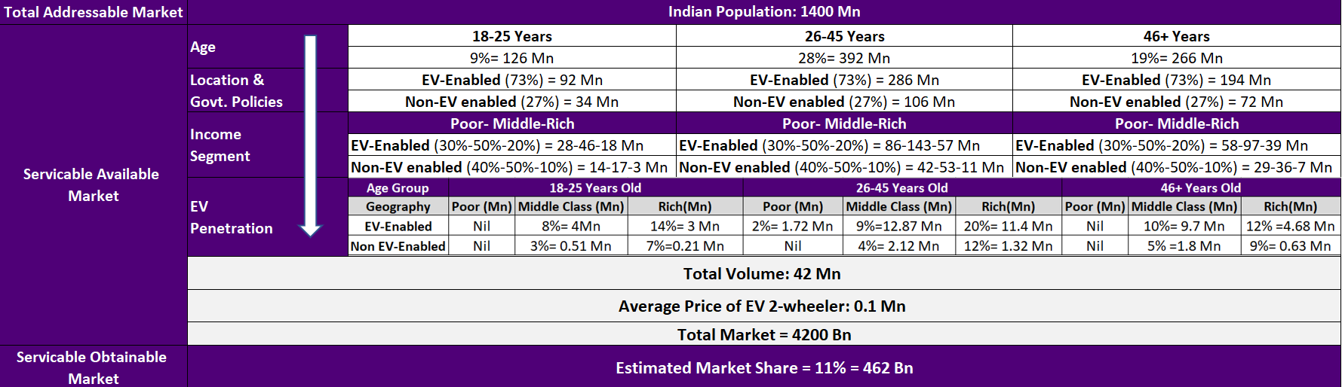




Opportunity market size of the electric two-wheelers in India
Note: EV-enabled refers to 13 Indian states where Govt. has approved dedicated EV policies – Maharashtra, Karnataka, Tamil Nadu, Delhi, Haryana, Chhattisgarh, Punjab, Haryana, UP, Rajasthan, Orissa, Gujarat, West Bengal. As per NITI Aayog, 95% of EV Revenue is generated through these 13 states. Acc. to Indian census, these states have 73% of the Indian population
Competitive Landscape
Market Drivers
Market Definition
The Urban Commuters
Students and Professionals
11 models
46K-95K INR
Cost of vehicle
Bicycle Subscription Model
B2B Business with Organization/ College/Workplace
Users - Commuting on-premises/ campuses
Hostel students
Age – 18 to 45
Rich and Middle Class
Urban areas from the 13 states with EV policies
Environment conscious people and Technology enthusiasts
1 model
110K-123K INR
Running Cost
2 models
100K-115K INR
2 models
100K-130K INR
Utility value
Industry & Pain points
Market Opportunity
GTM Strategy
Distribution & Marketing
Touchpoints & KPIs

Slide 4
















Diversified product portfolio for Indian consumers & proposed solution for identified issues
ABC Photon
ABC Photon+
ABC Hydra
Shared Charging
Infrastructure
Electric Scooter –EV for all, all for EV
Electric Bicycle – Save Money & Travel Responsibly
85-90 kmph
115-120 kmph
Low speed and Cruise mode
Speed
EV with/without Battery
Battery standardization
115-125 km
175-190 km
30 km with throttle and 35 km with Pedal assist
Battery Hiccups & Range anxiety solution
Range
Electric Vehicle
Battery Recycling
95-99k*
1.2-1.4 Lac*
Rental / Subscription based Model
Price
Value + Competitor based pricing
*with battery
Inhouse Battery
Manufacturing
B2B
B2C
B2B2C
B2B customers
Individual
Corporates
Educational Institutes
Co-working spaces
Transforming dealer to true EV advocates
Point of
Contact
Strategy &
Operations Manager
Application, Social Media,
Channel partners
HR / Sustainability Manager
Administration/
Student Body
HR/Operations Manager
Service anxiety
Reskilling & Incentivising dealers
Delivery Team
Individual
Employees
Students & Staff
Employees
User
Creating
Digital Ecosystem
Social Media Influencer, Online reviews
Social Media,
Influential Corporates Management
Social Media Influencers, Influential College Management
HR, Marketing
Team
Management
Influencer
New Age technology
Cloud connected
Smart alerts
Smart sensors
Gamification of website
Battery Management system
Competitors, Cost
Other Options to travel
Competitors, Other Options to travel
Institutional guidelines, Budget
Competitors, Other options to travel
Gatekeeper
Industry & Pain points
Market Opportunity
GTM Strategy
Distribution & Marketing
Touchpoints & KPIs

Slide 5
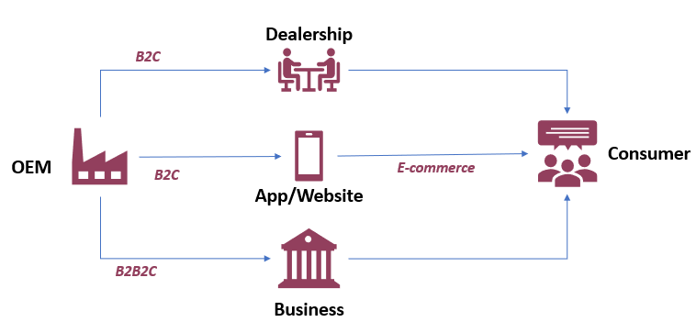



Distribution Channels and Creating Customer Awareness
Distribution Model
Campaign #rEVolution
Did You Know? - Spreading awareness on the benefits of EVs
Online Marketing
Social Media Marketing
Television and Over The Top Ads
Blogs, E-Magazines
Webinars, Online Town Halls
Offline
Interactive displays- malls, metro stations
EV Rallies
Billboards at strategic locations
Why ABC? - Details on Product Specifications, Service & USPs
Website and Application
Entering Gaming Arena
Customer Reviews
Influencer Marketing
Brand Recall
Sponsorships (Movies, Shows)
Target
Acquisition
Consumers –Technology and Sustainability Enthusiasts
Influencers - Review Channels,
Youth, Environmentalists
Direct Sales
Indirect Sales
Onus comes on OEM’s Salesforce
Higher Customer Satisfaction
Fixed prices without dealer markups
Higher Service Standards
Brand Value & Image are maintained
ABC has network of 700 primary dealers and 4000 secondary sub- dealers. We can’t alienate them
Onus of Warranty and Recall work on Dealers
Development of secondary market which maximizes value for consumer
Do it Now! –Initiatives to covert Potential Buyers to Customers
Satisfaction
& Retention
Test Drive booking
Experience Centres at Malls, Events
SMS and Email Marketing
Loyalty/Exchange Programs
Availability (Dealers, Website, App)
People interested in buying a 2W EV by 2023
Source – Primary Research
Industry & Pain points
Market Opportunity
GTM Strategy
Distribution & Marketing
Touchpoints & KPIs

Slide 6





Touchpoints during Customer journey and KPIs to measure success
Operational
Complaint TAT
Charging Stations Density
Service Centre Density
Research &
Planning
Pre-buying
Booking
Handover
Steady
State
Satisfaction & Engagement
Customer Reviews
Net Promoter Score
Happiness Score
App downloads
Clickthrough Rate
Bounce Rate
Number of Complaints
Consider, Explore, Compare, Research
Visits website/app for Specification and features
Booking, Payment, Delivery Information
Product Delivery, RC Documentation, Support
Maintenance,
Notification,
Feedback
Introduction to product through ads & social media
Referrals
SEO
Website UX/UI
Blogs, Social media posts, online reviews
Easy access to information
Easy booking
Billing Action
Great service support
Responsive actions
Confirmation of vehicle status
Thankyou messages
Notification of important dates
Helpline
Vehicle status
Smart Security Information about vehicle usage
Feedback Surveys
Community Groups
Loyalty Points
Decreasing order of priority
Measure of Success (KPIs)
Diagram: Digital touchpoints to engage potential customers
Outcome
Volumes
Dispatch to Market Share
Vahan Market Share
Vehicles sold per density
Number of Unique Users
Store Footfall
Accessories sold/vehicle
Maximize Incremental
Volumes
Enter Overseas EV Market leveraging pre-build network
Strengthen Forward and Backward Linkages
Diversify Product Portfolio to cater different demographics
Minimize Cannibalization by EV Entry
Segmented Positioning of ICE and EV Products
Gradual Scale-Up and convert 100% products into EV by 2030
Focus on Customer Value and Market Expansion
Industry & Pain points
Market Opportunity
GTM Strategy
Distribution & Marketing
Touchpoints & KPIs

